Slide 1
1
WHONET Training Course Modules
Required modules
1
Introduction to WHONET
Laboratory configuration
Data entry
Data analysis – Overview
Data analysis – Interactive analysis
Data analysis – Quick analysis

Slide 2
Module 6. Data analysis – Quick analysis
6
A
Introduction to Quick analysis
B
WHONET Standard reports – Screen and Excel
C
WHONET Standard reports – Word
D
User-defined reports
E
DHIS2 – Brief introduction
F
WHONET Automation Tool – Brief introduction

Slide 3
6
Benefits of WHONET reports
In WHONET Quick analysis, the data analyst can create automatic “reports”, which combine the results of several analyses into a single output.
Reports can be shared with partners in the laboratory, pharmacy, infectious diseases, infection control, national authorities, collaborating organizations, and funders.
Like WHONET macros, reports save time and promote consistency with repeated analyses.
One WHONET user can create reports for many other WHONET users, which promotes standardization and collaborative discussions of results both within a single institution and across many institutions.
WHONET reports can be automated to run on a periodic basis (daily, weekly, monthly, etc.)

Slide 4
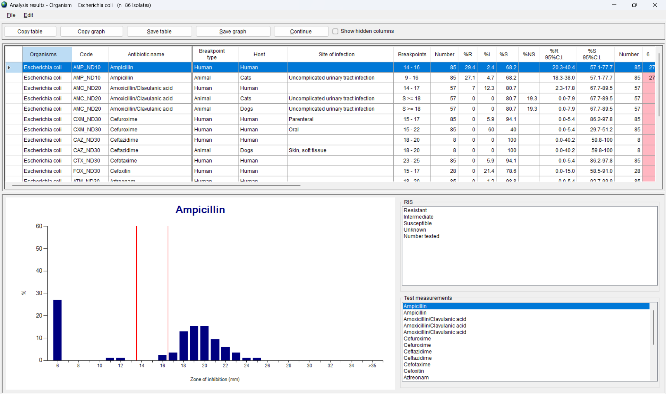
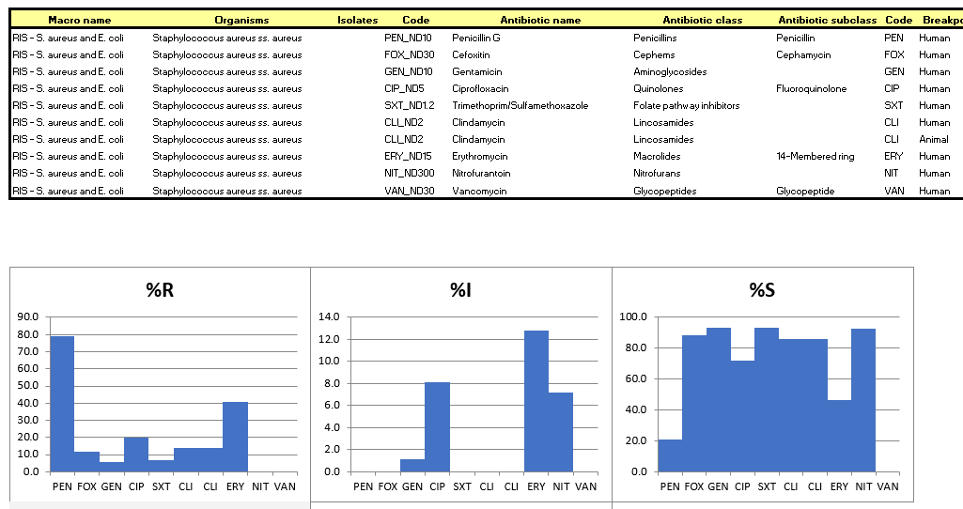
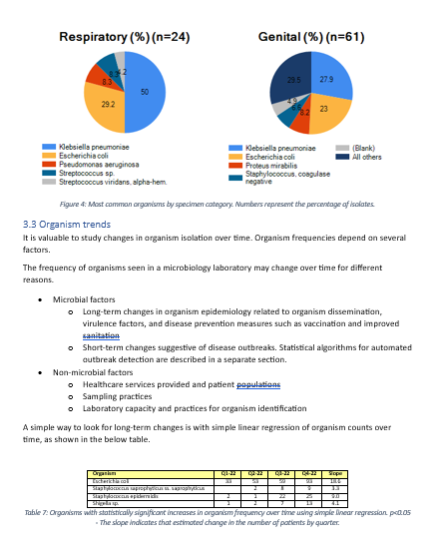
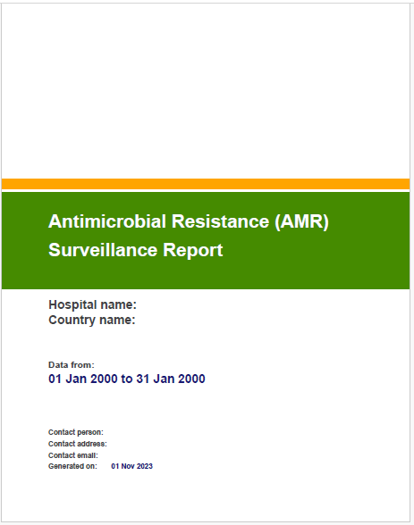
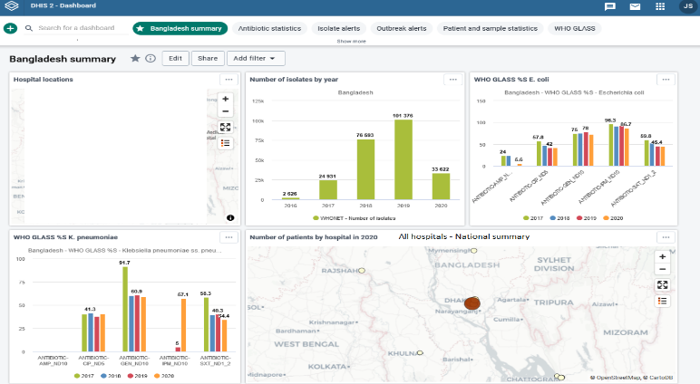
Output options
6
Screen
Excel
Word
PDF (AMASS)
DHIS2
www.amass.website
www.dhis2.org

Slide 5
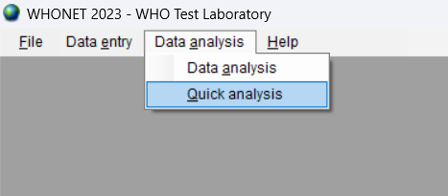
Select Quick analysis
6
B

Slide 6
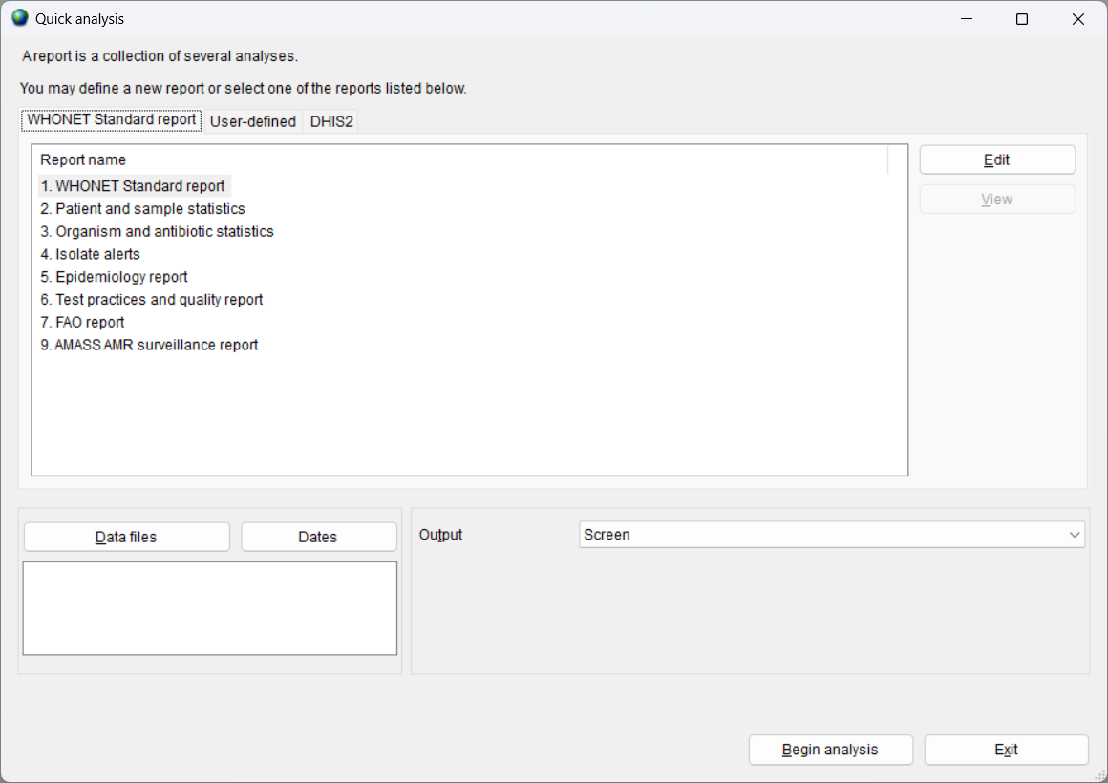
6
Quick analysis – report types
WHONET Standard reports
Screen, Excel, Word, and PDF
User-defined reports
Screen and Excel
DHIS2
DHIS2 “Data Set” files
DHIS2 “Meta-data” files

Slide 7
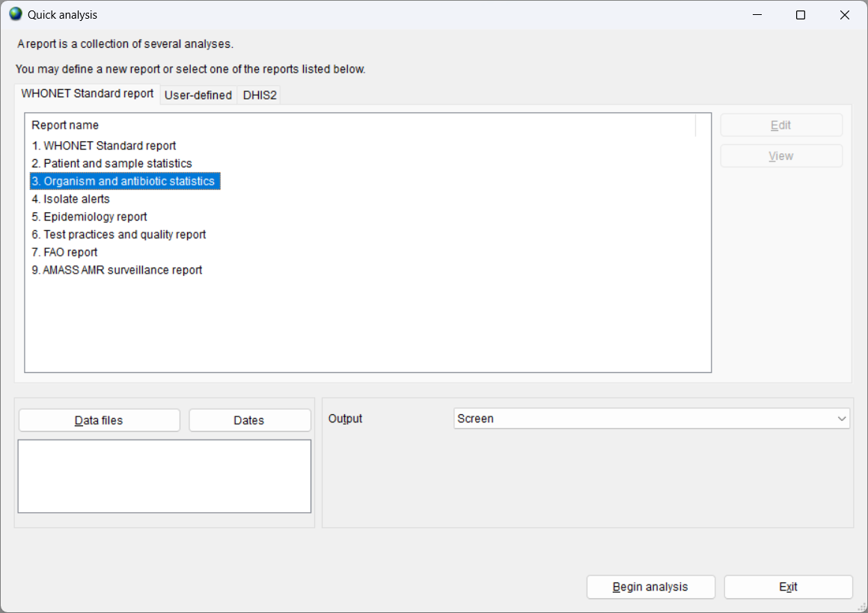
6
Quick analysis parameters
Choose a report
Choose a data file or many data files
Choose the output destination
Screen, Excel, Word, or PDF
The valid choices will depend on which report you select

Slide 8
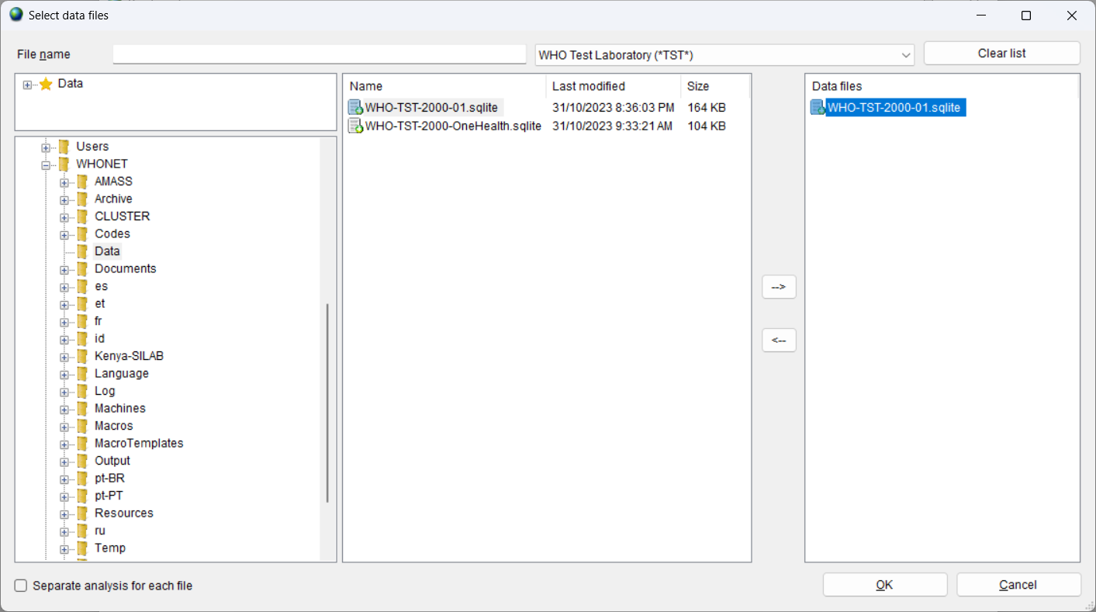
Choose the data files
6
B
Choose one or more data files
The data files can be from one laboratory or from many laboratories

Slide 9
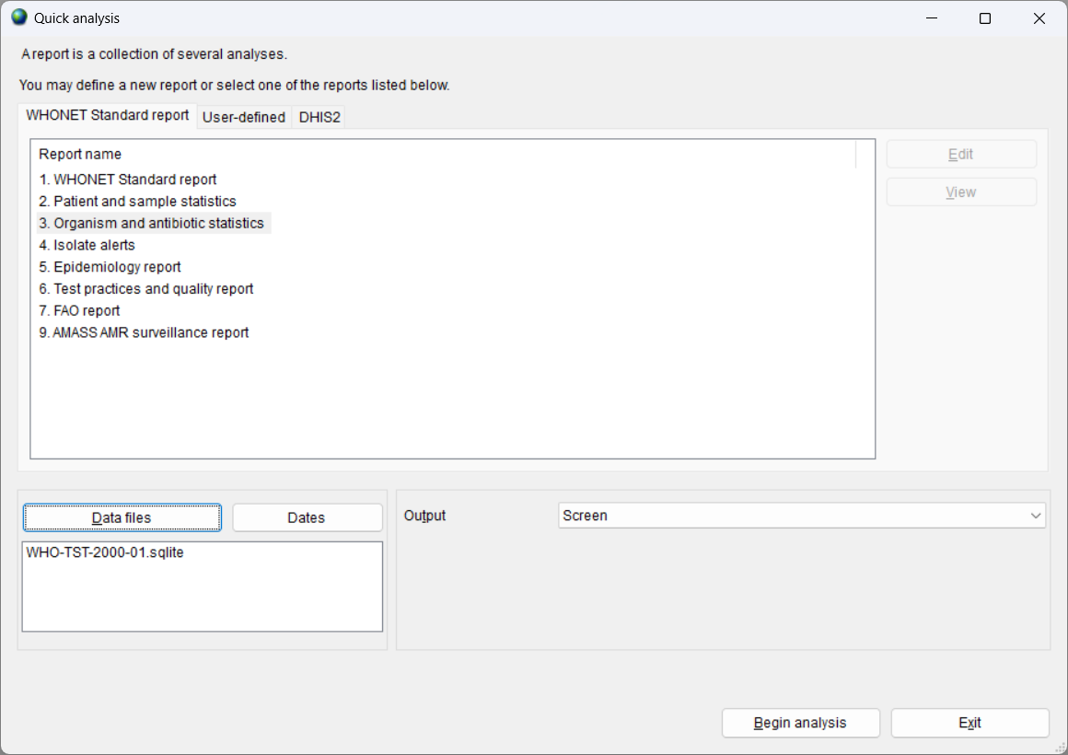
6
The data file is selected

Slide 10
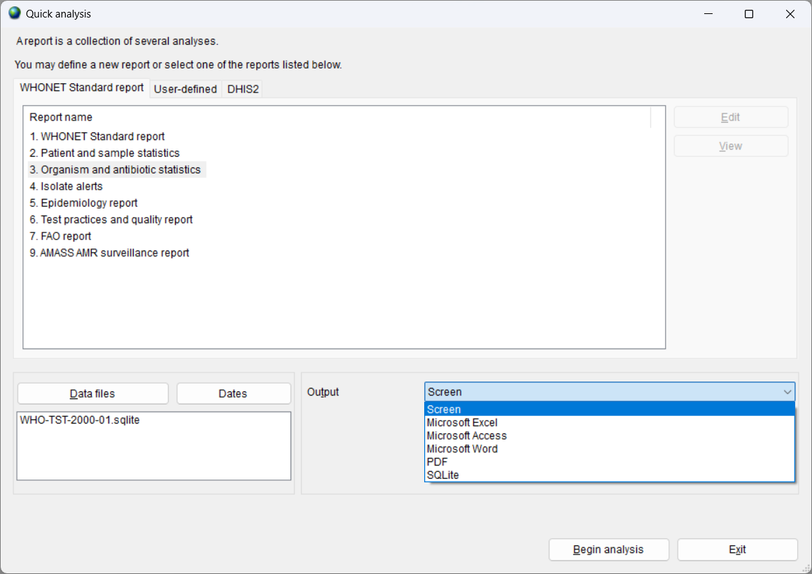
6
Quick analysis – Output options
The specific output options will depend on which report you choose.
Some reports were developed for the screen and Excel, while other reports were developed for Word, PDF, or DHIS2.

Slide 11
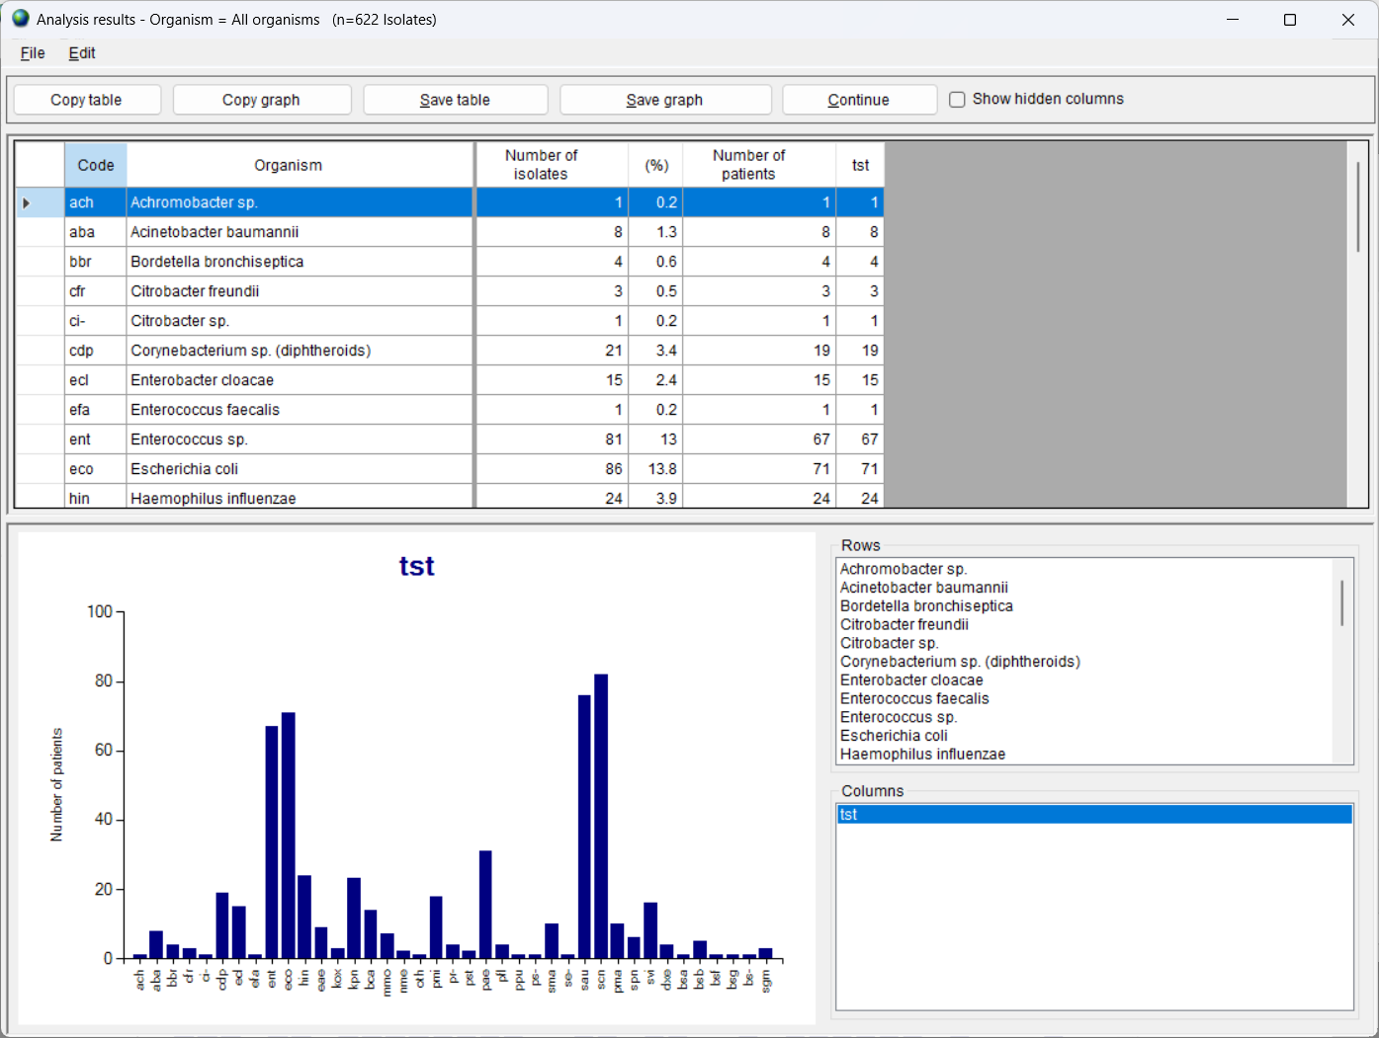
6
Organism and antibiotic statistics
Organism by laboratory
Review the results
Choose the graphs
Copy or save the results
Click on “Continue” when finished to proceed with the next analysis in the report

Slide 12
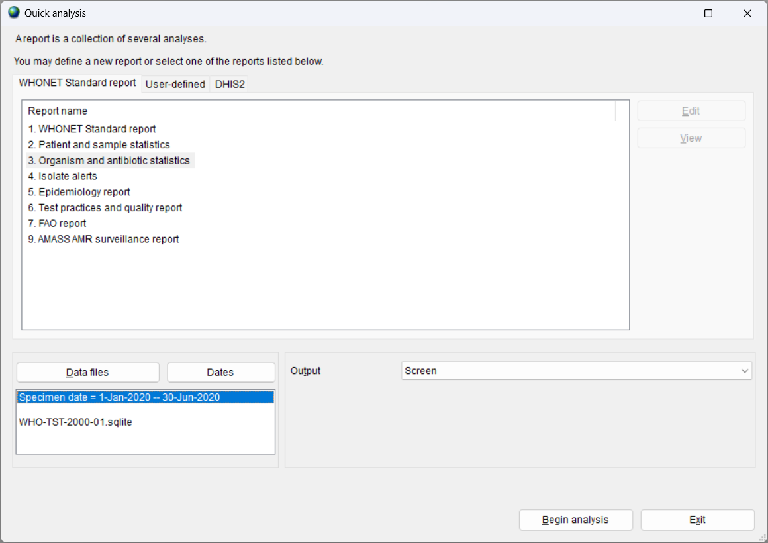
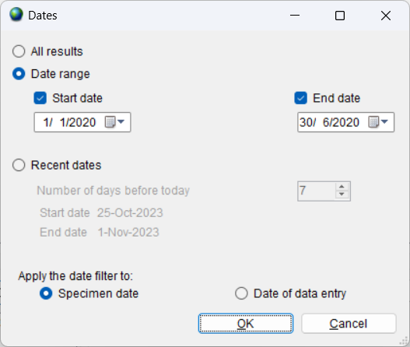
6
Including a date filter
This feature is useful if you are only interested in a subset of dates.
It is also useful to filter out incorrect specimen dates such as “January 1, 1990” or “March 20, 2050”.

Slide 13
6
Module 6. Data analysis – Quick analysis
A
Introduction to Quick analysis
B
WHONET Standard reports – Screen and Excel
C
WHONET Standard reports – Word
D
User-defined reports
E
DHIS2 – Brief introduction
F
WHONET Automation Tool – Brief introduction

Slide 14
6
WHONET Standard reports
Screen and Excel
Screen and Excel
2. Patient and sample statistics
3. Organism and antibiotic statistics
4. Isolate alerts

Slide 15
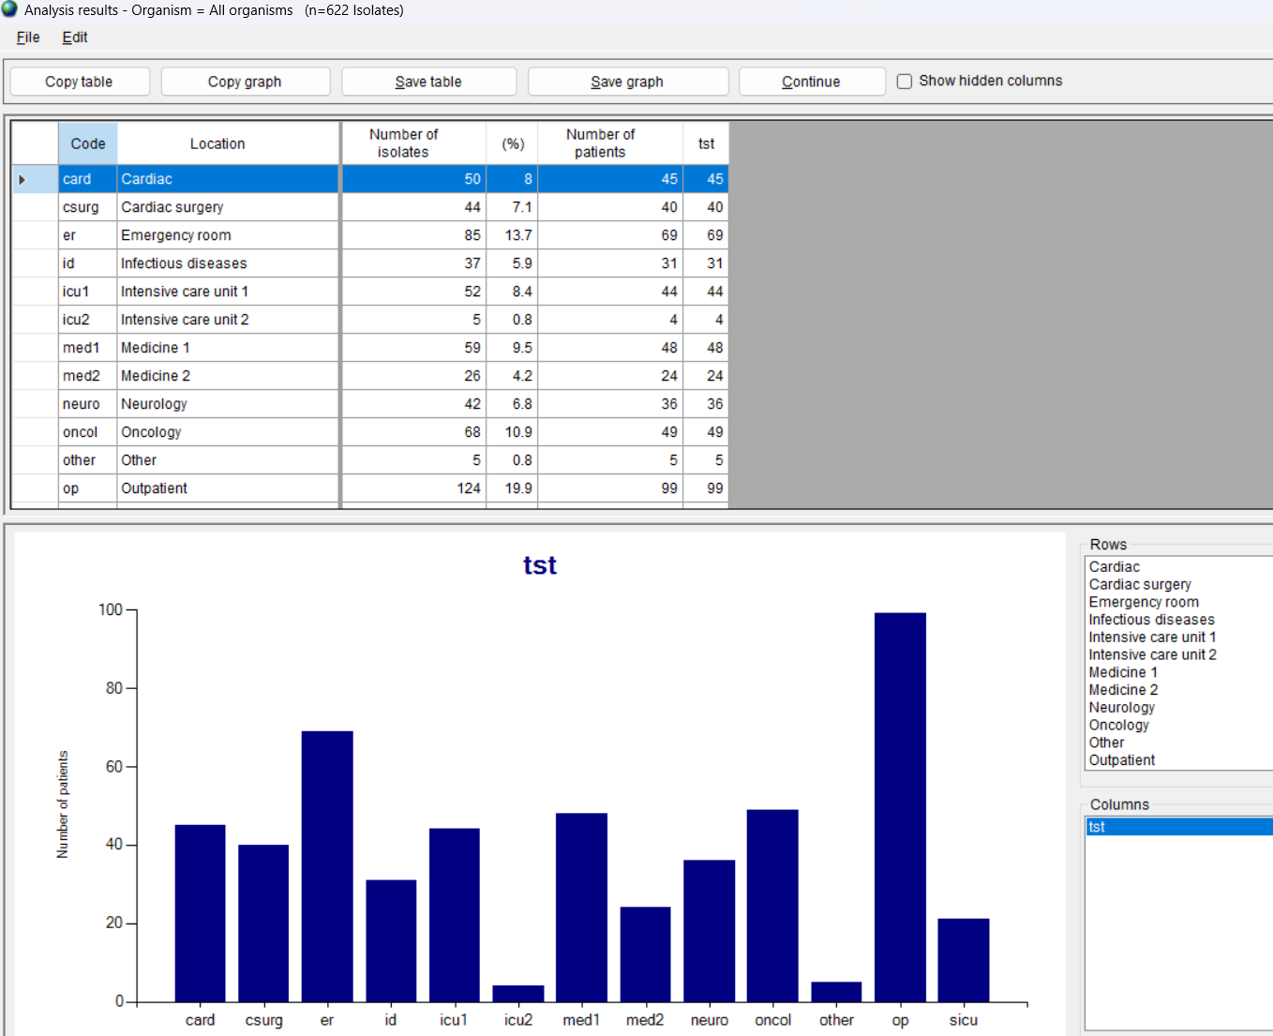
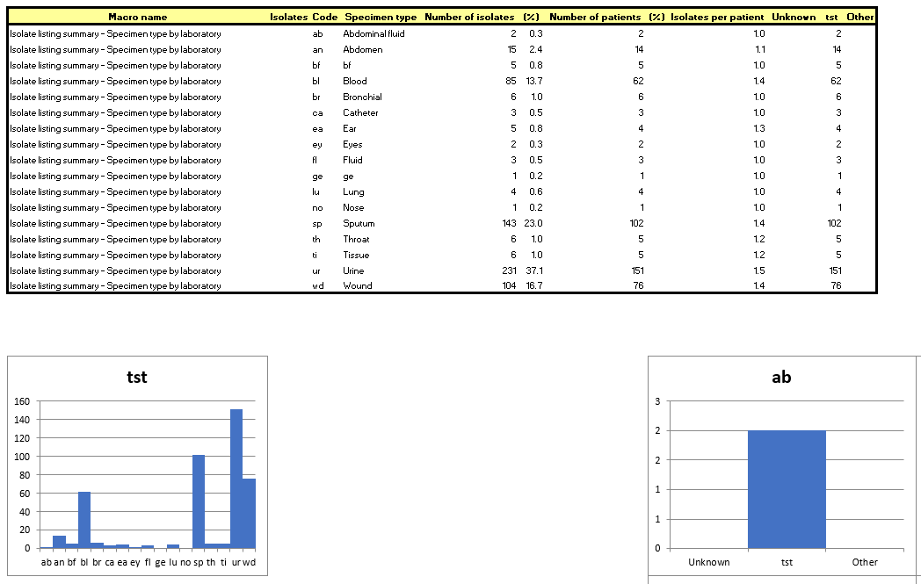
6
WHONET Standard report
Patient and sample statistics
Analyses
Laboratory by specimen month
Sex by laboratory
Age group by laboratory
Location by laboratory
Location type by laboratory
Specimen type by laboratory
Laboratory by location
Laboratory by specimen type
Screen
Excel

Slide 16
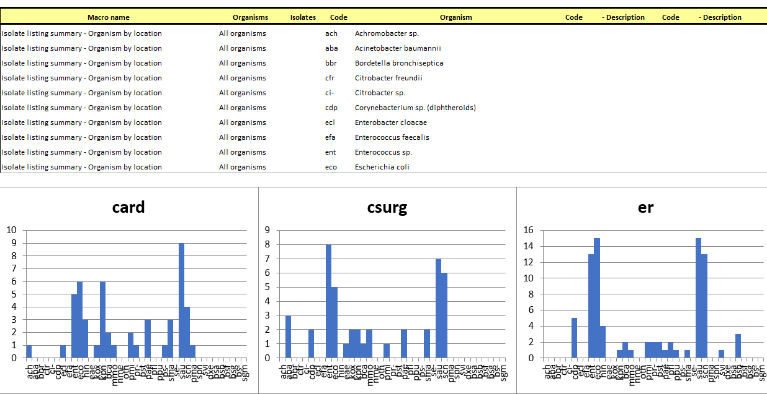
WHONET Standard report
Organism and antibiotic statistics
6
Organism
Organism by laboratory
Organism by specimen month
Organism by sex
Organism by age group
Organism by location
Organism by location type
Organism by specimen type
Antibiotics
%RIS for Staphylococcus aureus
%RIS for Escherichia coli
Gram-positive antibiogram
Gram-negative antibiogram
Organism by location
%RIS for Escherichia coli
Excel
Screen

Slide 17
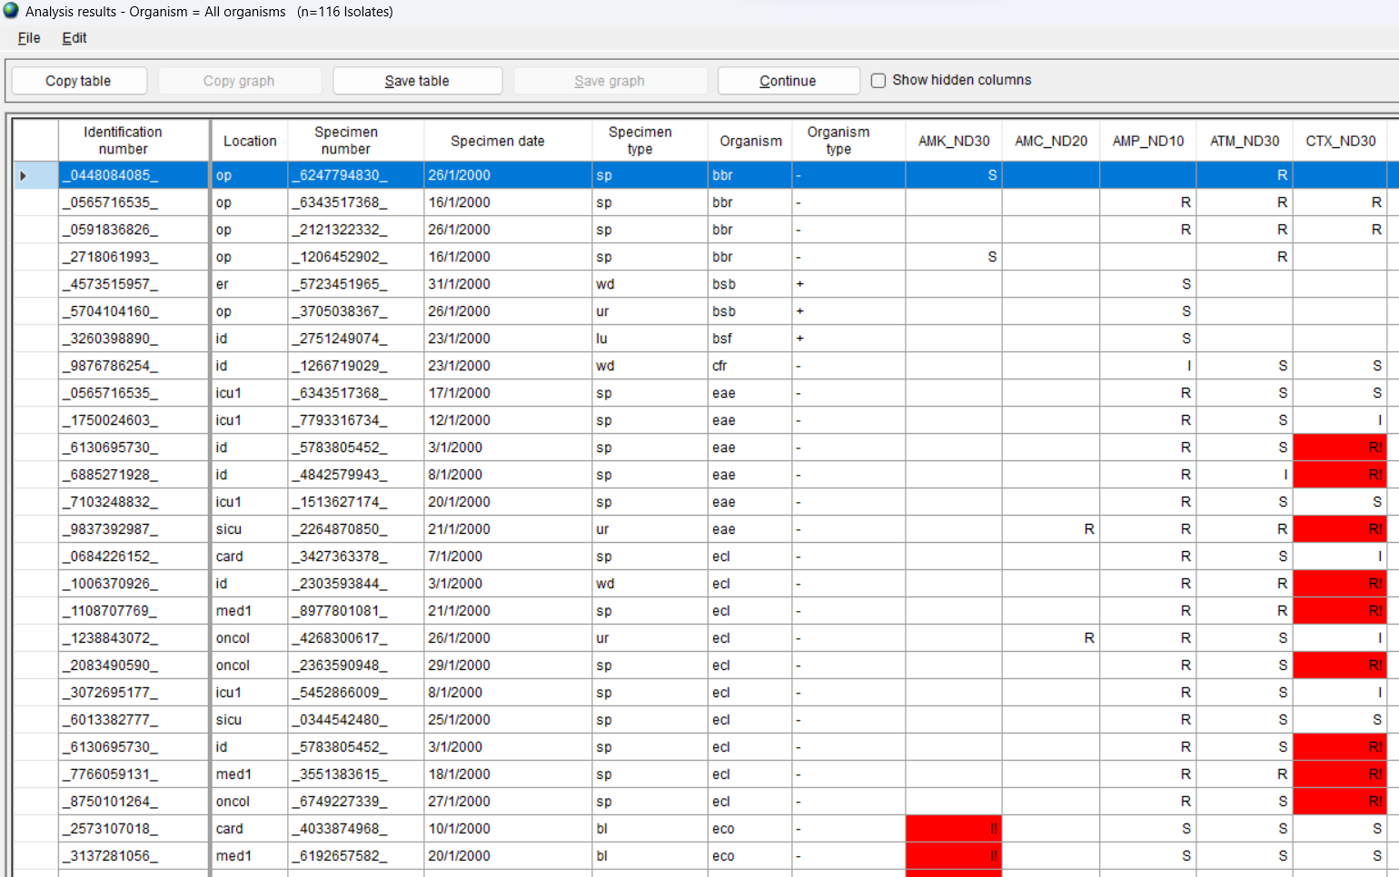
WHONET Standard report
Isolate alerts
6
Alerts for important species and important resistance
Listing
Summary
Alerts for quality control
Listing
Summary
Listing – Important species and important resistance
Summary – Quality control alerts
Screen
Excel

Slide 18
6
Module 6. Data analysis – Quick analysis
A
Introduction to Quick analysis
B
WHONET Standard reports – Screen and Excel
C
WHONET Standard reports – Word
D
User-defined reports
E
DHIS2 – Brief introduction
F
WHONET Automation Tool – Brief introduction

Slide 19
6
WHONET Standard reports
Microsort Word
Word
5. Epidemiology report
6. Test practices and quality report
7. FAO report (in development)

Slide 20
6
Output: Microsoft Word
Advantages
The report focuses on the highest priority results, for example “Top 10 organisms” with a lot of explanatory text.
The report can easily be printed and shared with local, national, and international colleagues
Disadvantages
The focus is certain priority results defined by the WHONET team.
The content and formatting of the report is rigid, and cannot be edited by the user
In future versions of the report
We will include some ability to customize the report – logos, text, content, criteria, thresholds, etc.
We will start to include some automated “highlights” and “recommendations”.

Slide 21
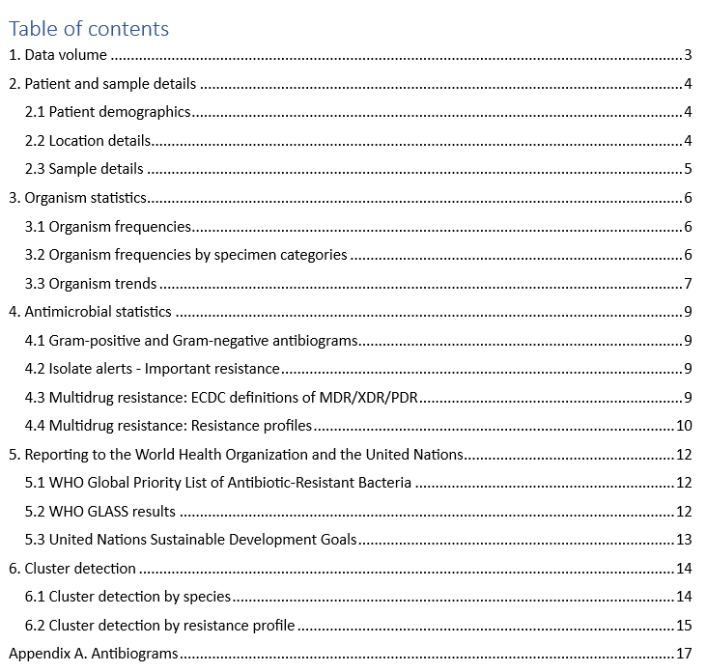
WHONET Standard report
Epidemiology report – Pages 1 and 2
6

Slide 22
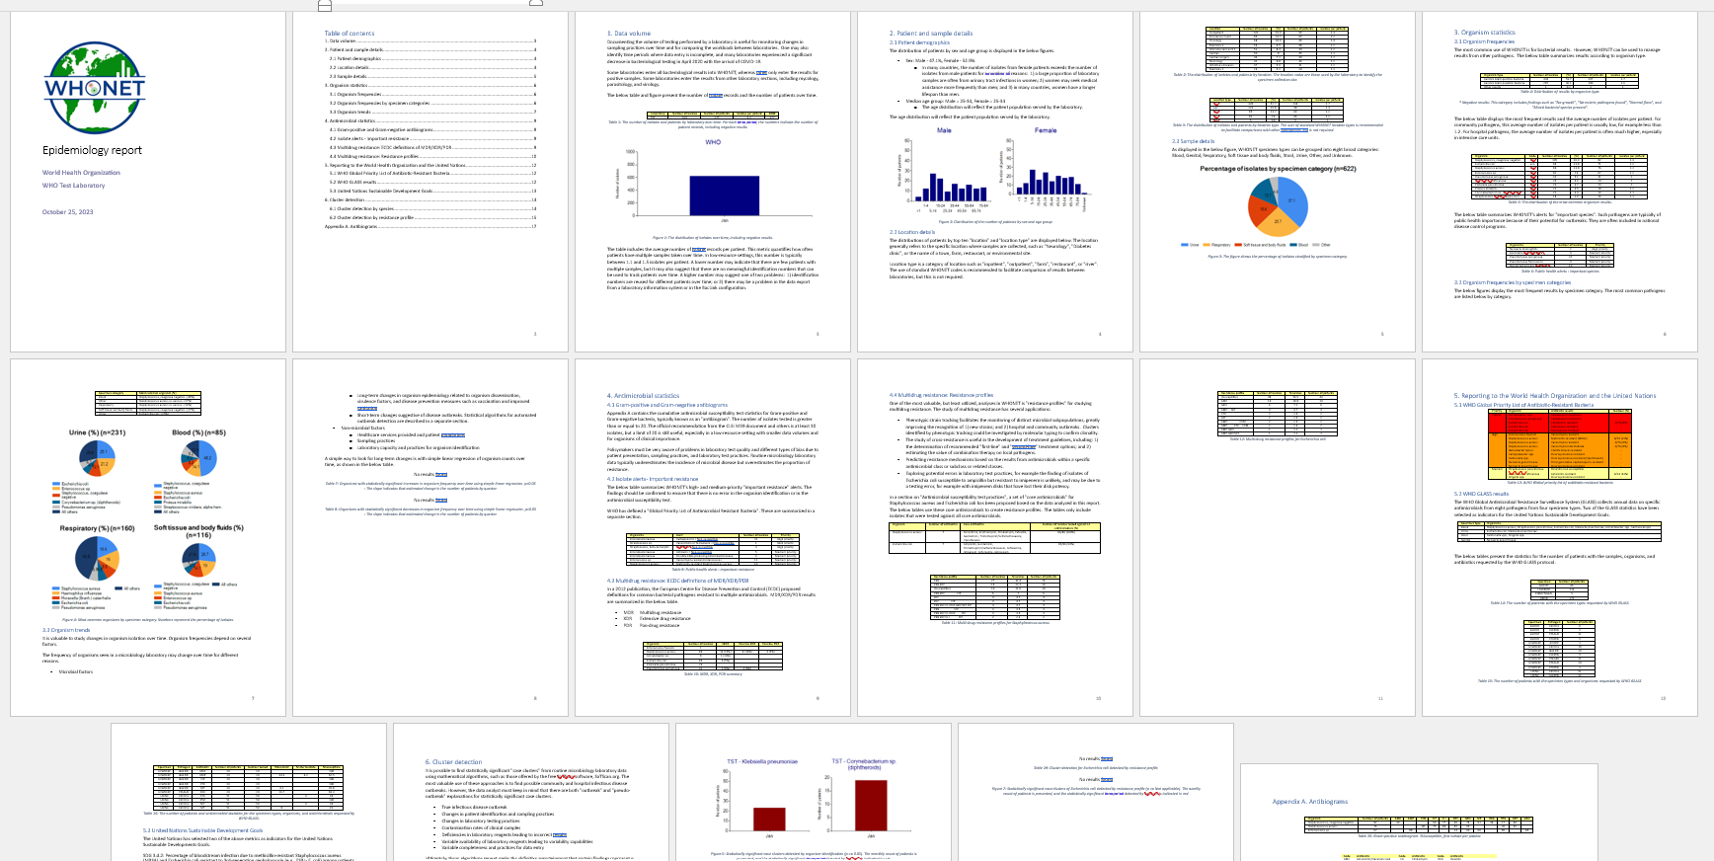
WHONET Standard report
Epidemiology report – Full report
The document is a mixture of texts, graphs, and tables divided into different sections.
Most of the results can be generated through “Data analysis”.
Some of the analyses were created specially for this report.
Specimen categories
Temporal trends
MDR/XDR/PDR
WHO Priority resistance
Sustainable Development Goals

Slide 23
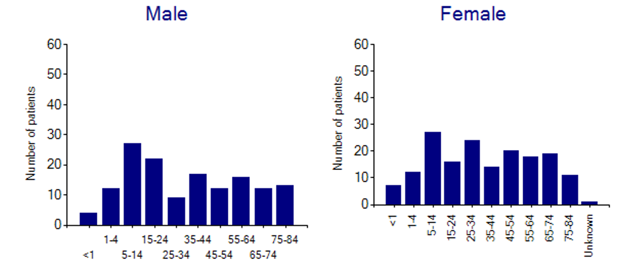
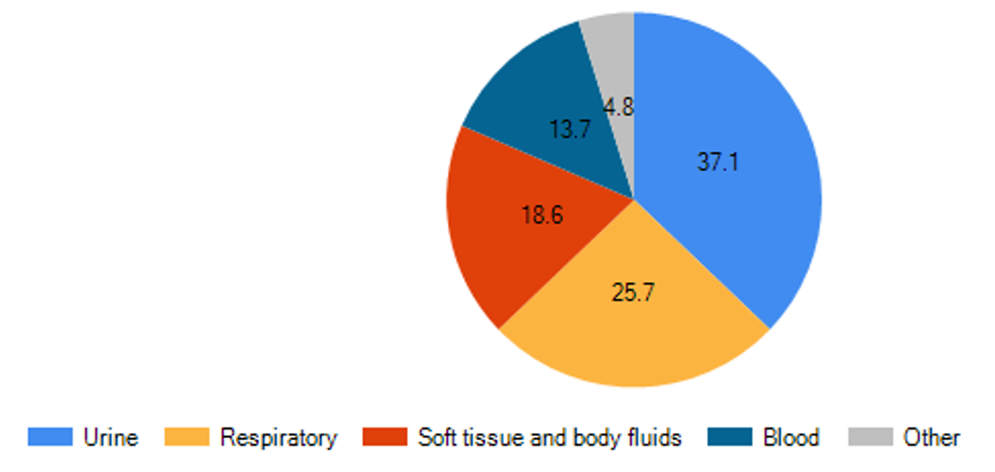
Epidemiology report
Patient, location, and sample statistics
Table 1. Isolates and patients by laboratory and year
Table 2. Most common locations
Figure 2. Age groups by sex
Figure 3. Specimen categories

Slide 24
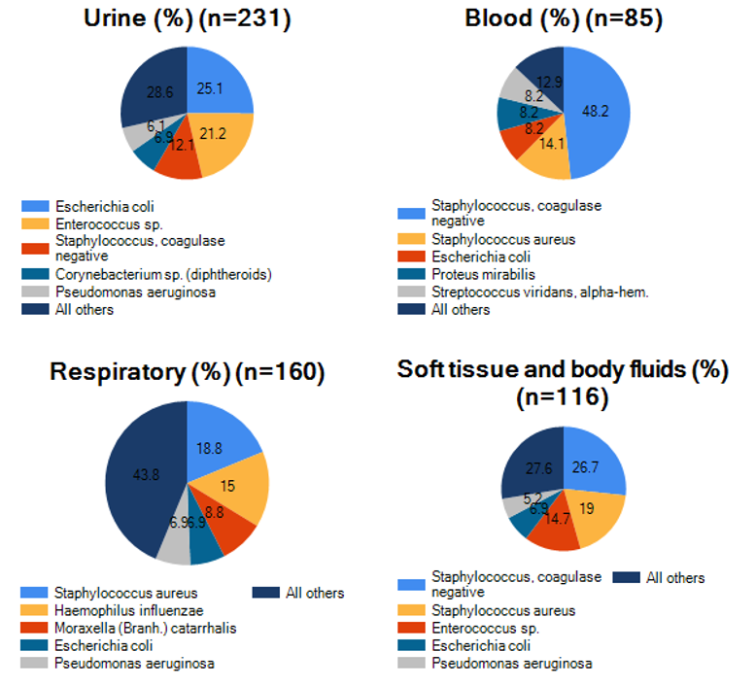
Epidemiology report
Organism and sample statistics
Table 5. Most common organisms
Table 6. Important species
Figure 4. Organisms by specimen category
Table 7. Organisms increasing over time

Slide 25
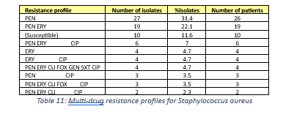
Epidemiology report
Antibiotic statistics
Table 9. Important resistance
Table 23. Gram-negative antibiogram
Table 10. Multidrug resistance
ECDC definitions
Table 11. Multidrug resistance
WHONET resistance profiles

Slide 26
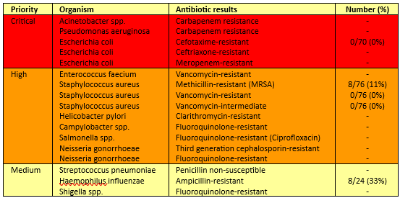
Epidemiology report
WHO and UN reporting
Table 14. WHO GLASS-AMR Sample categories
Table 13. WHO Priority resistance
Table 16. WHO GLAS-AMR %RIS Statistics
Section 5.3 UN Sustainable Development Goals – Antimicrobial resistance indicators

Slide 27
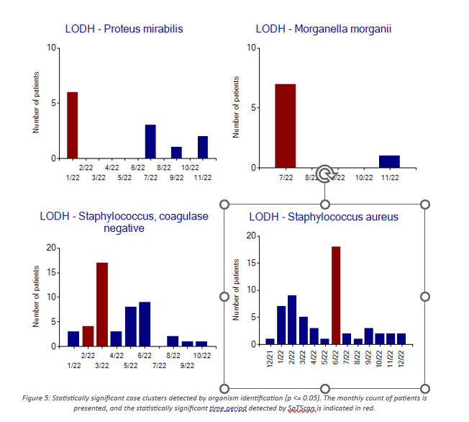
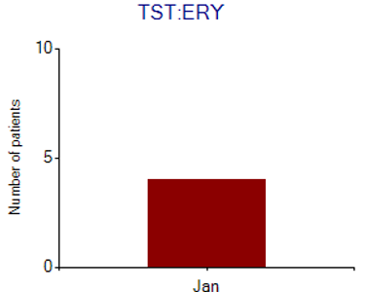
Epidemiology report
Cluster detection
Table 17.
Table 13.
Figure 6.
Figure 5.*

Slide 28
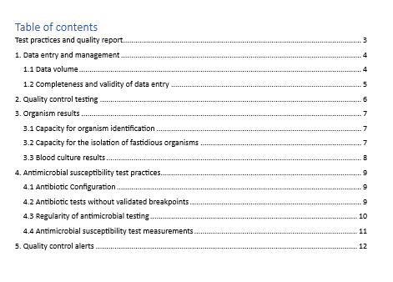
Report Test practices and data quality
Cover page and Table of contents
6

Slide 29
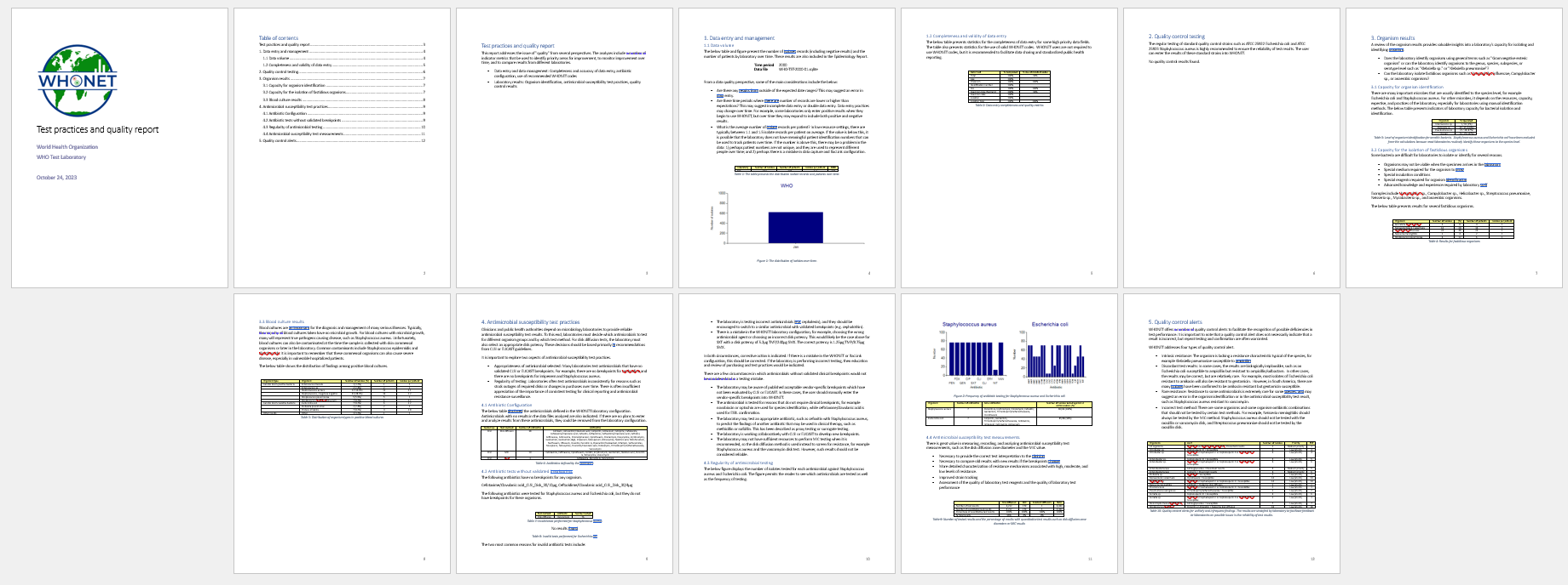
Report - Test practices and data quality
Full report
The document is a mixture of texts, graphs, and tables divided into different sections.
Most of the results can be generated through “Data analysis”.
Some of the analyses were created specially for this report.
Specimen categories
Temporal trends
MDR/XDR/PDR
WHO Priority resistance
Sustainable Development Goals

Slide 30
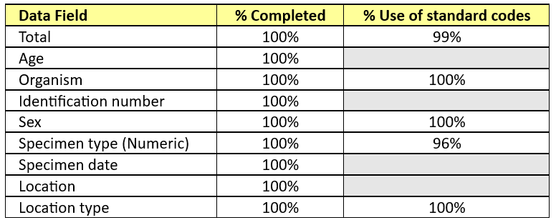
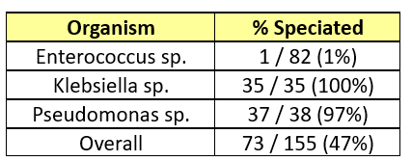
Test practices and data quality report
Data quality and organism findings
Table 4. Capacity for isolation of fastidious pathogens
Table 2. Data completeness and validity
Table 3. Capacity for species identification
Table 5. Blood culture results

Slide 31
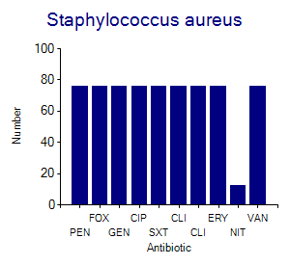
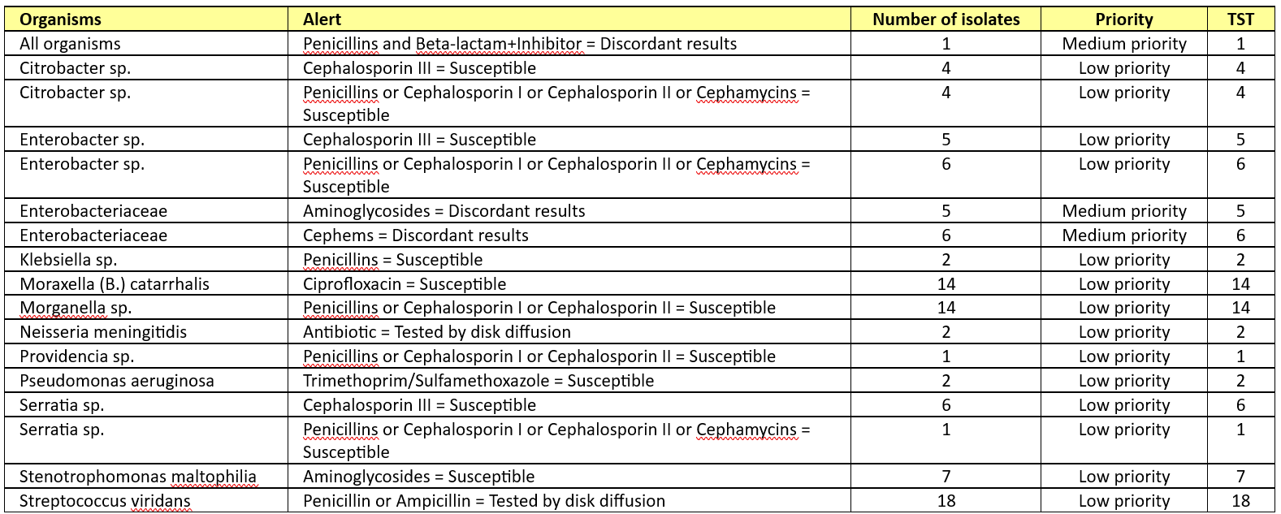
Test practices and data quality report
Antimicrobial susceptibility testing
Table 7. Invalid tests for Staphylococcus aureus – No breakpoints
Table 9. Recording of test measurements
Figure 2. Regularity of testing
Table 10. Infrequent and unlikely test results

Slide 32
Module 6. Data analysis – Quick analysis
6
Module 6. Data analysis – Quick analysis
A
Introduction to Quick analysis
B
WHONET Standard reports – Screen and Excel
C
WHONET Standard reports – Word
D
User-defined reports
E
DHIS2 – Brief introduction
F
WHONET Automation Tool – Brief introduction

Slide 33
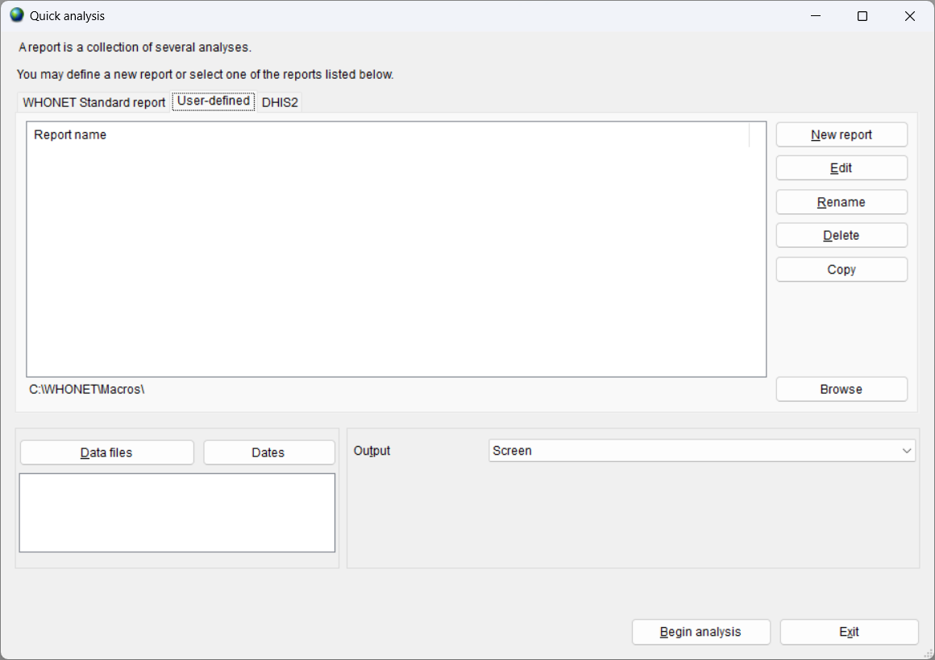
6
User-defined reports
When you begin with WHONET, there are no user-defined reports.
You can use “New report” to create reports. For example:
Daily, weekly, and monthly reports
Reports for the laboratory, pharmacy, and infection control team

Slide 34
6
User-defined reports
Advantages
You define macros in Data analysis to define all of the analysis parameters you need: Analysis type, Organisms, Isolate filters, Data files, and other options.
These can be customized depending on the needs of your local and national collaborators.
Results can be viewed on the screen and shared in Excel files.
You can share your reports with other WHONET users.
Disadvantages
You must create these macros yourself.
At the present time, you can only create “Screen” and “Excel” reports.
In the future, you will also be able to create “Microsoft Word” reports.

Slide 35
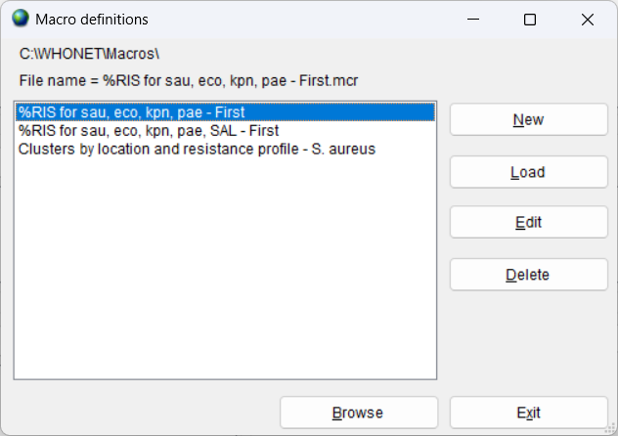
6
Before you create a new report
A user-defined report is a collection of macros that you have created.
Therefore, the first step is to go to “Data analysis” and create a series of macro.
The “Data analysis” training module provided steps for creating three macros:
Gram-positive antibiogram
Gram-negative antibiogram
Gram-negative antibiogram in blood
(Screen grab needs to be updated)

Slide 36
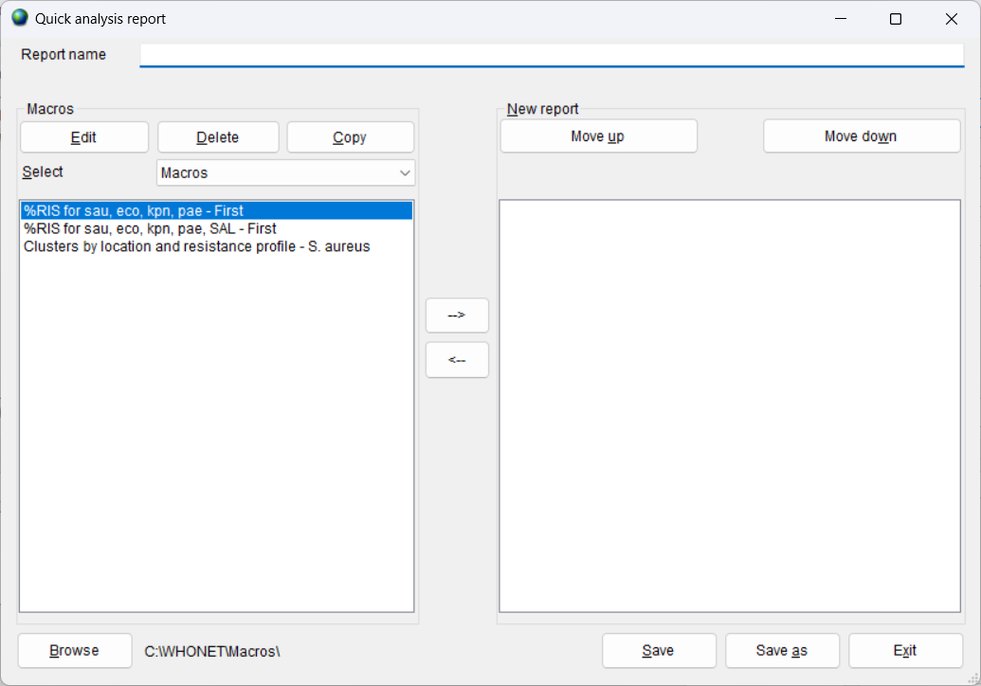
6
Creating a new report, Part 1
From “User-defined reports”, click on “New report to get the below screen.
Give a name to the new report, for example “Antibiogram report”.
On the left, you will see the list of macros that you have previously defined. (You can use “Browse” to change the folder.).
Choose the macros on the left that you would like to include in the report by double-clicking or by using the arrow buttons.

Slide 37
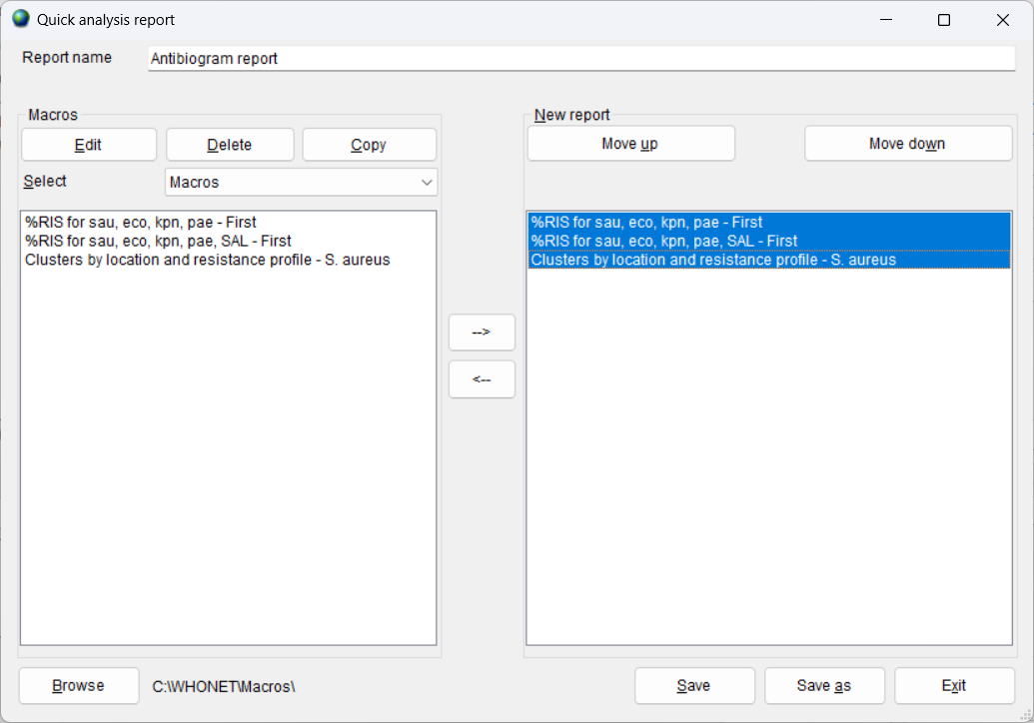
6
Creating a new report, Part 2
Give a name to the new report, for example “Antibiogram report”.
On the left, you will see the list of macros that you have previously defined. (You can use “Browse” to change the folder.).
Choose the macros on the left that you would like to include in the report by double-clicking or by using the arrow buttons.
You can use “Move up” and “Move down” to change the sequence of the macros.”
Click on “Save” when you are finished to same the report name: “Antibiogram report”.
Click on “Save” again to save the report file: “Antibiogram report.rpt”
Then click on Exit to close the screen.

Slide 38
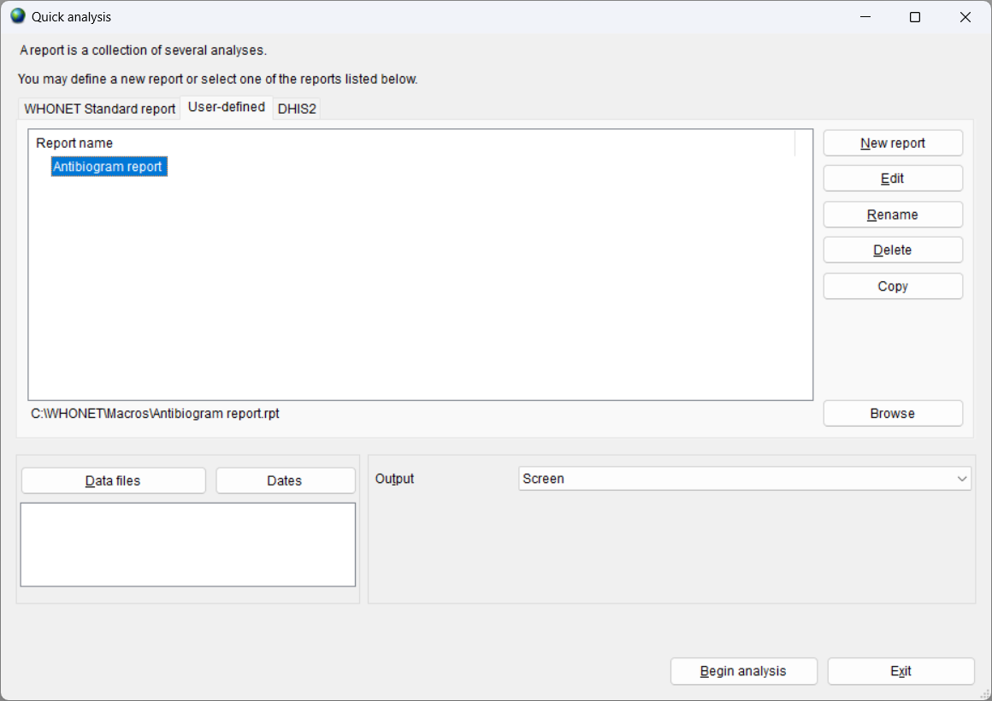
6
Using a report
Select the report
Choose your data file or your data files
Choose “Screen” or “Excel”
Choose “Begin analysis”
WHONET will then show the results of the macros included in the report.
Other options include “Edit”, “Rename”, “Delete”, and “Copy”

Slide 39
6
Report results on the screen
Click “Continue” to advance to the next macro. Or you can click on “File”, “Stop analysis” to end the analysis immediately.

Slide 40
6
Report results in Excel
When WHONET finishes the analysis, it will ask you if you want to open the report. Select “Yes”. If you do not see your report immediately, then click on the Excel icon at the bottom of the screen.
The name of the Excel file will include the name of the report and the date of the analysis, for example “Antibiogram report.2020-01-01.xlsx”. The default location is C:\WHONET\Output.
There will be one Excel sheet for each analysis.

Slide 41
Editing a report using WHONET
Go to Quick analysis, and click on “User-defined”.
You will see a list of all of the reports. Choose the report that you are interested in. Click on “Edit”.
You will then see the macros that are defined for the report. You can add, remove, or reorder the macros. A report may also include subreports. When you finish, click “Save” or “Save as” and “Exit”.

Slide 42
Editing a report using NotePad
Reports are simple text files and can be edited with any text editor, such as NotePad.
By default, WHONET reports are saved in C:\WHONET\Macros.
Find the report that you wish to edit. You can edit this file, or you can make a copy and edit the copy.
Windows File Explorer
NotePad

Slide 43
How to share or backup a report
By default, macro and report files are stored in the location C:\WHONET\Macros.
From here, you can make backup copies or send copies to your colleagues by email.
Reports only contain a list of macros and subreports. They have no confidential information in them, so can be freely shared with collaborators.

Slide 44
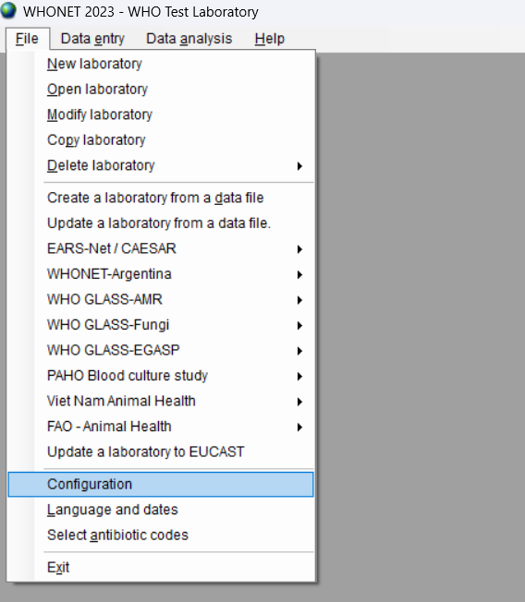
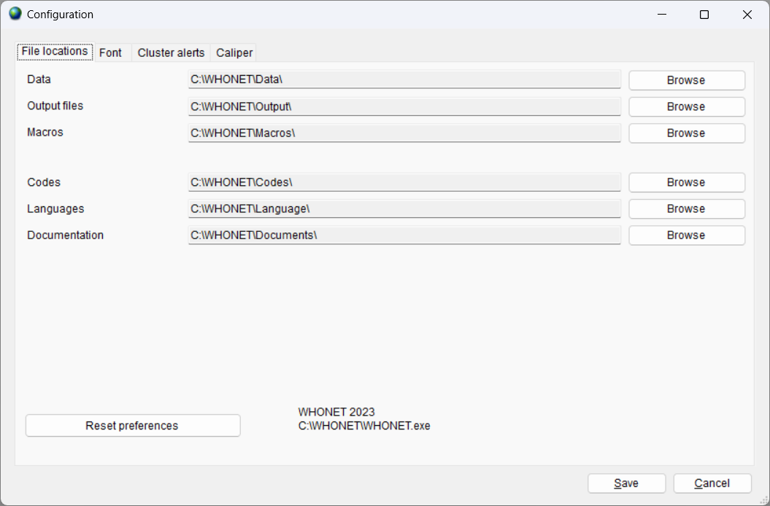
Default location for macros and reports
By default, WHONET macros are saved in the folder C:\WHONET\Macros
You can change this location through the “Configuration” option on the main “File” menu.

Slide 45
6
Module 6. Data analysis – Quick analysis
A
Introduction to Quick analysis
B
WHONET Standard reports – Screen and Excel
C
WHONET Standard reports – Word
D
User-defined reports
E
DHIS2 – Brief introduction
F
WHONET Automation Tool – Brief introduction

Slide 46
Module 4. Data analysis - Overview
6
DHIS2 is a widely used web-based data analysis and visualization platform used by Ministries of Health for public health surveillance.
It is managed by the University of Oslo, www.dhis2.org.
The DHIS2 features of WHONET will be covered in separate training module.
B

Slide 47
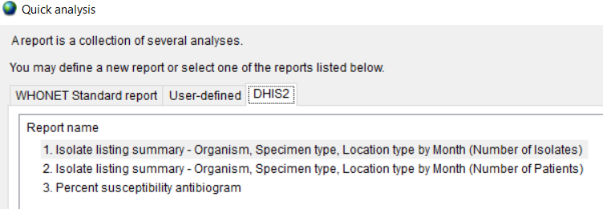
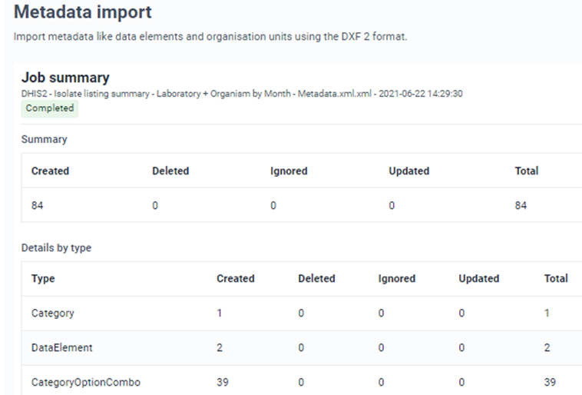
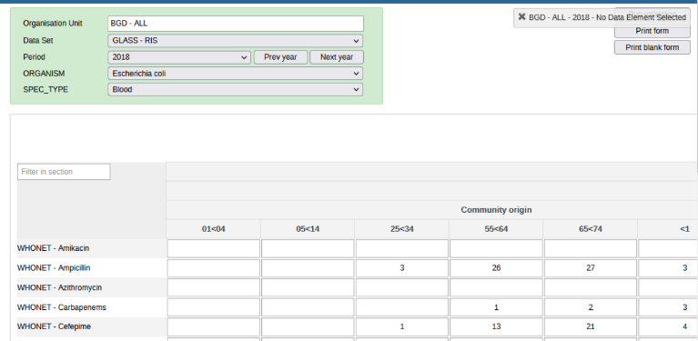
6
WHONET-DHIS2 Interoperability
Metadata, Data Set, and Event import
1. Export analysis results from WHONET
2. Import results into DHIS2
Map edited for confidentiality
3. See the results in DHIS2
4. Visualize the results in DHIS2 with maps and charts

Slide 48
6
Module 6. Data analysis – Quick analysis
A
Introduction to Quick analysis
B
WHONET Standard reports – Screen and Excel
C
WHONET Standard reports – Word
D
User-defined reports
E
DHIS2 – Brief introduction
F
WHONET Automation Tool – Brief introduction

Slide 49
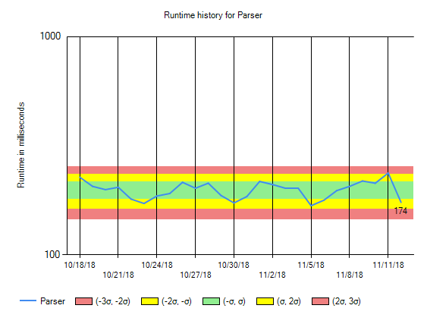
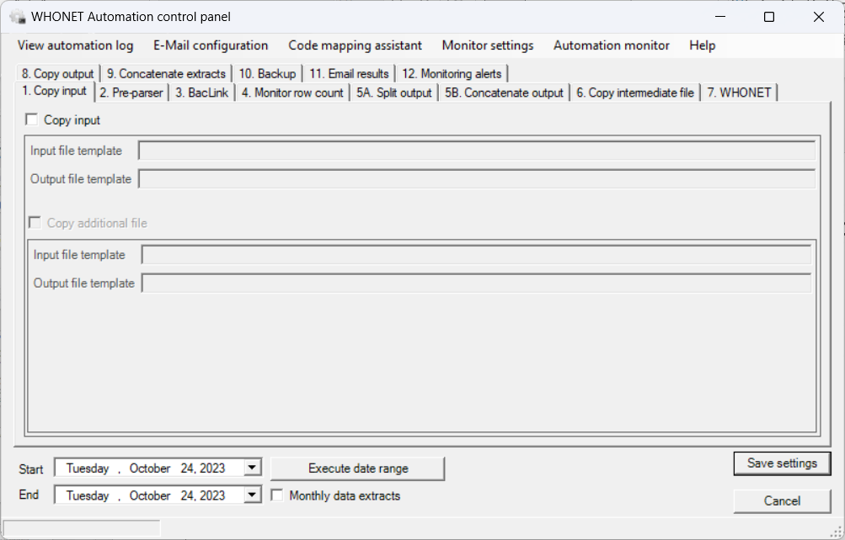
6
WHONET Automation Tool
The WHONET Automation Tool can bring automated daily, weekly, and monthly reports.
Alerts for important isolates and possible outbreaks
WHONET and BacLink alerts for data quality issues
Steps that can be automated include: BacLink, WHONET, file backups, event monitoring, and email notifications of data managers, laboratory staff, infection control teams, and national authorities.
The use of the WHONET Automation Tool will be covered in a separate training module.

Slide 50
6
Thank you for watching Module 6
Congratulations! That concludes the WHONET Training Course. Thank you for watching.

